Slide 1
Which Outbreaks of Animal Diseases Will Lead To Human Getting Sick.
Xinyao Wu

Slide 2
Structure of presentation
Basic introduction of dataset
Normal Xgboost process & result
New Design ---- Information Flow
Result
Future improvement

Slide 3
Basic Introduction
With outbreaks of animal diseases in some regions data, I want to build a classification model to achieve a high prediction accuracy.

Slide 4
Dataset Description
Original dataset ---> 10078 * 24
The features includes:
(1) Index info ( ID, source,species info...)
(2) Geographic info (longitude, latitude, region, country,...)
(3)Numeric info( sum of deaths,sum of destroyed cases,...)

Slide 5
Data Preparation
(1)Classification ----> Binary outcome
Whether ‘human affected’ is NA or not
(2)Reduce the amount of redundant information
(3) Transform categorical features to numerical(matrix)

Slide 6
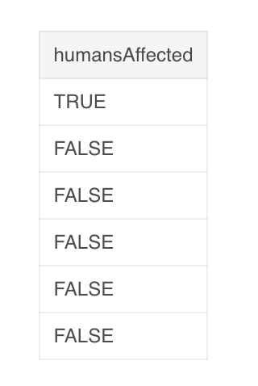
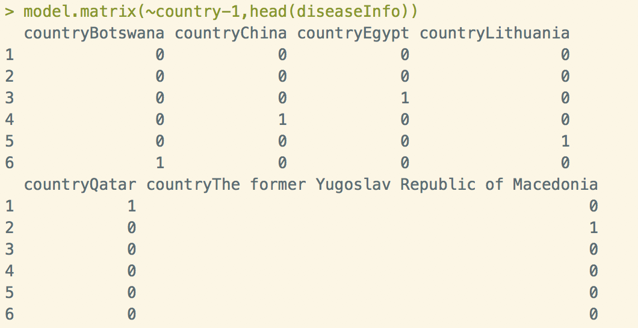
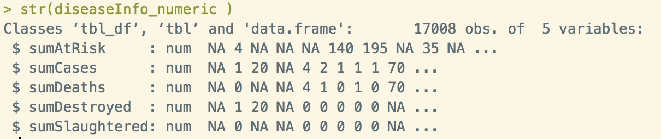

Slide 7
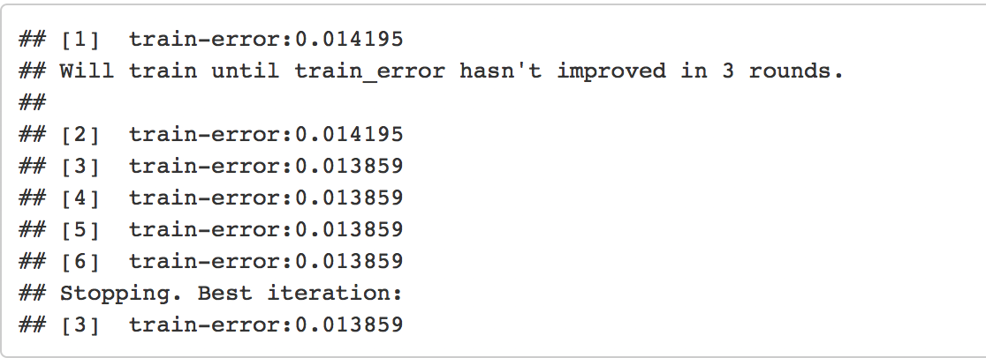

Gradient Boosting (Xgboost)
Misclassification rate is 0.0139.
Training Data
70%
Testing Data 30%

Slide 8
The Potential Problems --- Imbalanced Class
In the Original data, Positive cases only takes 0.08331373
How to control for imbalanced classes?
Tuning Model.
Give the positive and negative cases information of training set when building the model
However, the result does not have obvious improvement.

Slide 9
New Design
Based on facts:
large enough dataset (10078 records)
Tuning the model mainly by giving classification information
My assumption:
Data over 2000 records can be seemed representative
Classification info of large dataset is more closed to truth
Information Flow
Building a series of models instead of only one
Each model using the previous information for tuning

Slide 10
For each bootstrap:
The information I added for each step is the classification odds predicted by the previous model.
Training Set
50%
Directly Predict
Add Info
Tuning Set 20%
Add Info
Randomly sample inside each bootstrap
Inside Test Set 20%
Add Info
Test Set 10%

Slide 11
Train & Test Set Design
Bootstrap 100 times
Sample Structure 5:2:2:1
For each time :
(1)Randomly select 90% :
50% for training ----->fixed within each bootstrap
then randomly sample 20% for tuning , 20% for testing
(2) last 10% for testing ----->fixed within each bootstrap

Slide 12
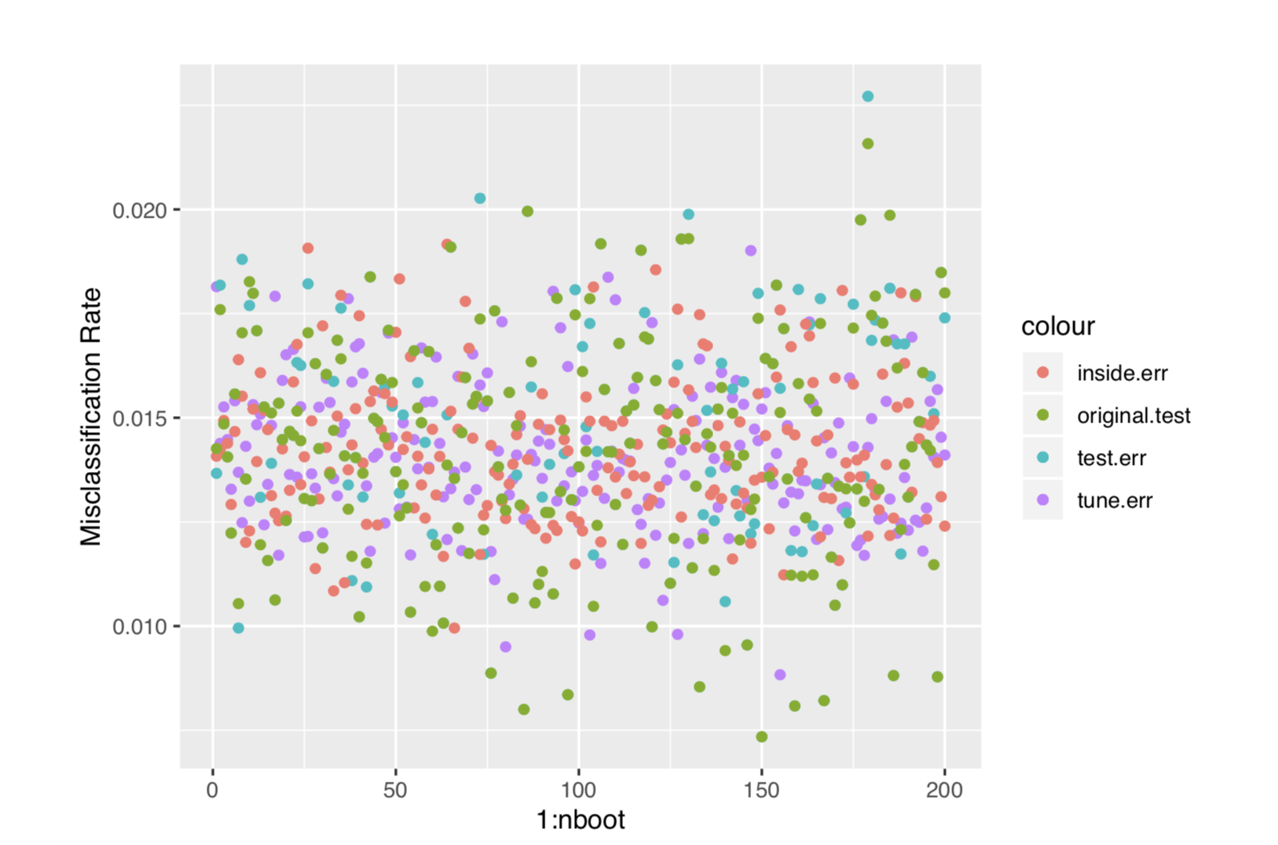
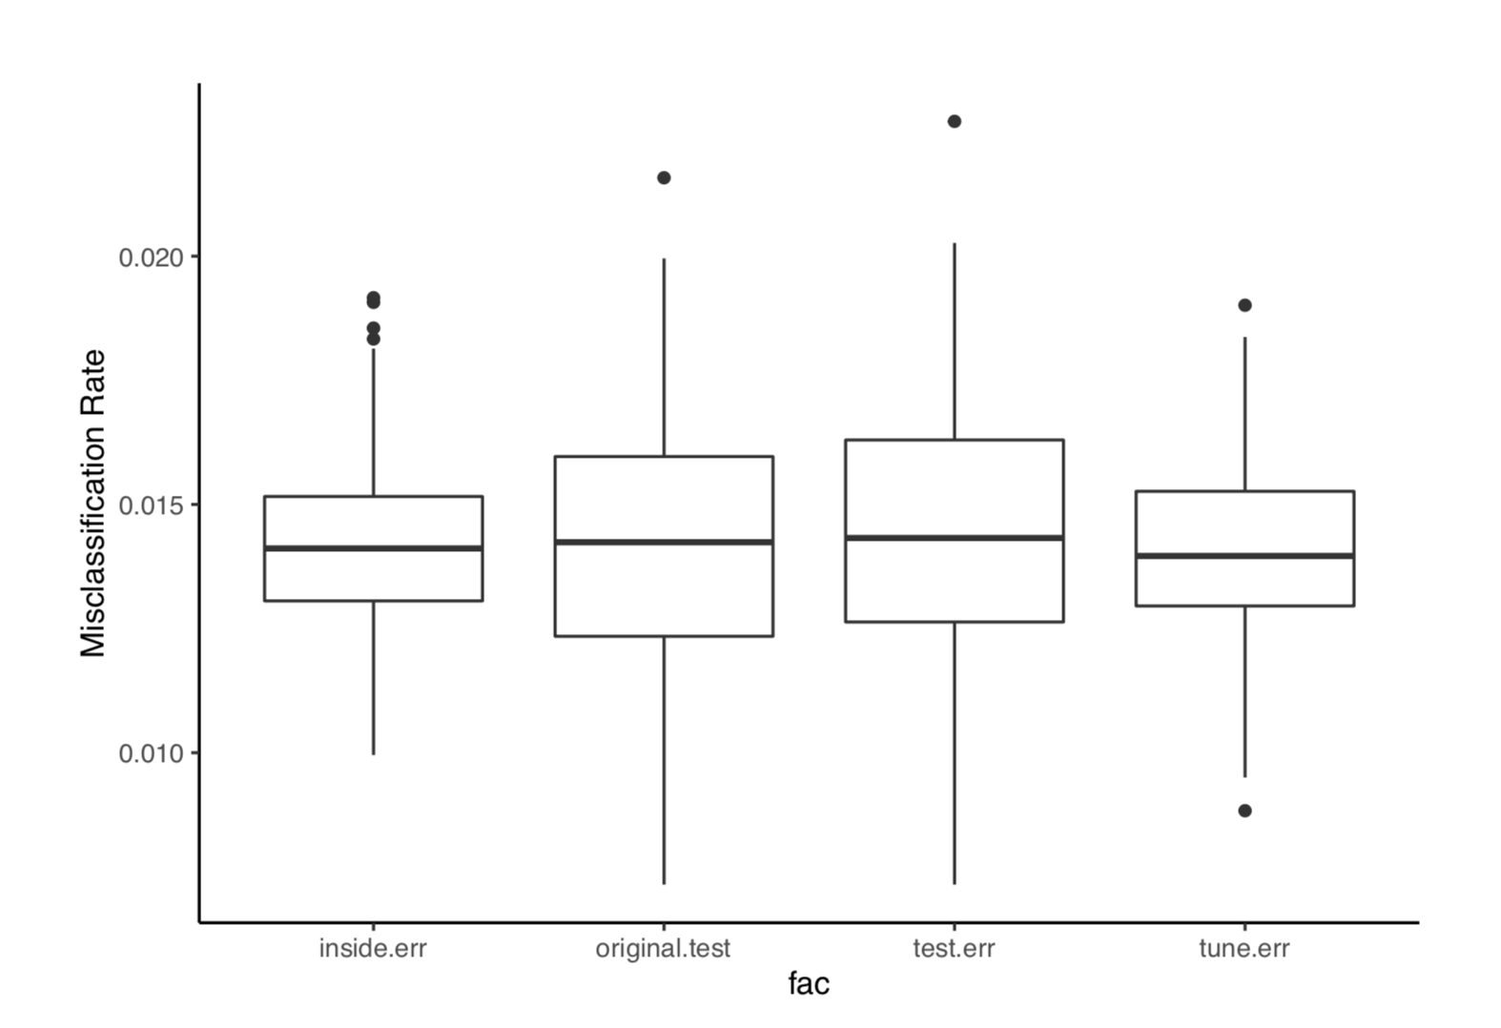
Bootstrap 200 times
Layer2 Direct Layer3 Layer1

Slide 13
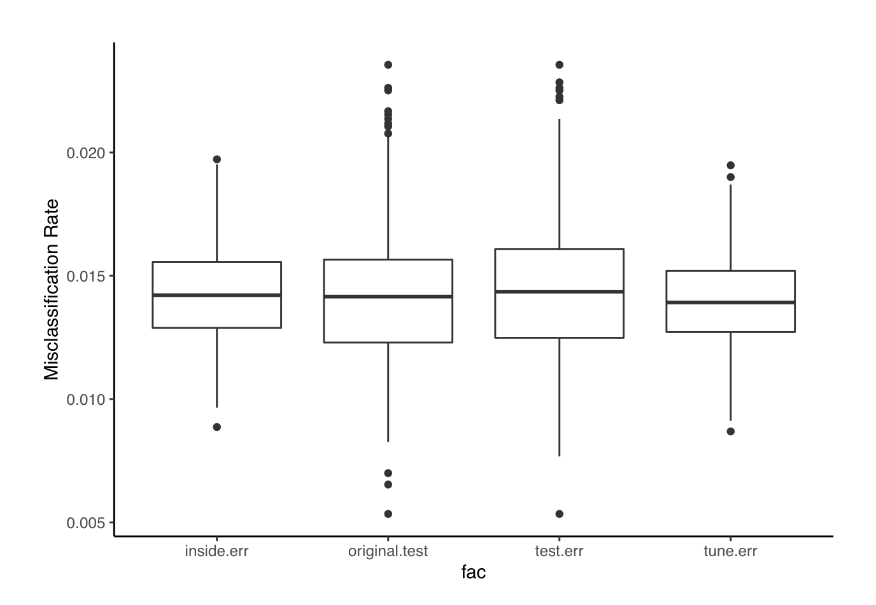
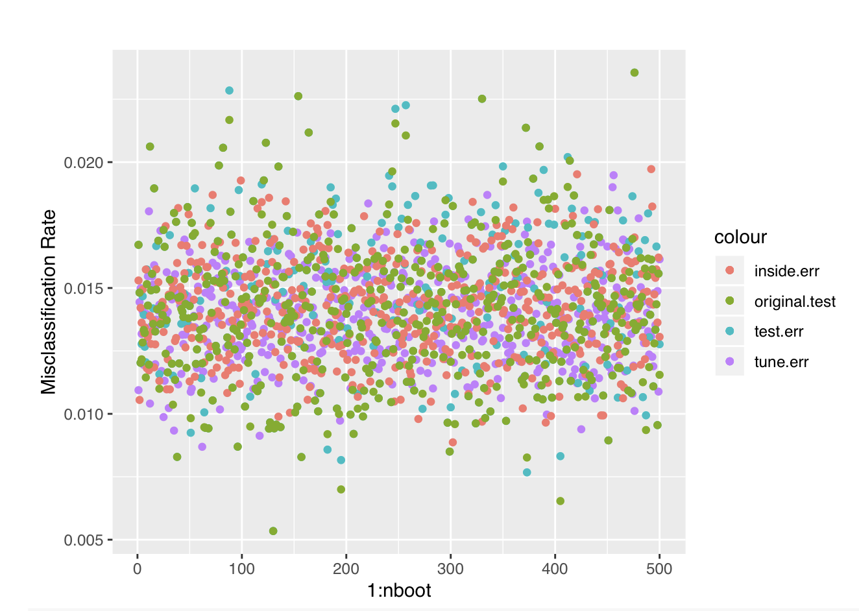
Bootstrap 500 times
Layer2 Direct Layer3 Layer1

Slide 14
Why may cause this result?
Sample size too large that provide sufficient accuracy for the first model
Lacking resample in inside testing
Misclassification is low enough and has little improvement space
Just to check whether the information flow can improve accuracy, sample small data set.
Add 1 inside resample and expand the layers to 5 to see if any improvement

Slide 15
Conclusion
Considering that only splitting original data set into two set may limit the space for tuning model, I come up with an information flow process framework that gives more space for tuning when already building a model based on large training set.
Training Set
50%
Directly Predict
Add Info
Tuning Set 20%
Add Info
Randomly sample inside each bootstrap
Inside Test Set 20%
Add Info
Test Set 10%

Slide 16
Discussion
For this dataset, the difference of two methods outcome is not obvious. The indirect model misclassification rate even is higher than that of direct model.
Potential reasons may be original dataset is large, lacking resample inside or small improvement space for original model
There are some potential problems in dataset, for example, when we transform the categorical variable into matrix and add it into dataset, will this action decrease the weight of other numeric variables?
The binary feature of whether the animal is wild or not, seems to be highly related to the outcome(which is binary). If we use a binary feature dominant associated dataset to build a model, will the improvement of accuracy is highly limited?

Slide 17
Thanks for listening!
Q&A Time

